Slide 1
Human Body System
By-Siddhant Narayan Mali

Slide 2
Body Systems
An organ system is a group of organs that work together as a biological system to perform one or more functions. Each organ does a particular job in the body, and is made up of distinct tissues.
There are twelve distinct organ systems in human beings, which form the basis of anatomy. Other animals have similar organ systems, although simpler animals may have fewer organs in an organ system or even fewer organ systems. Plants too have organs, such as flowers and leaves, and these are grouped into organ systems as well.

Slide 3
Integumentary System
The integumentary system is an organ system consisting of the skin, hair, nails, and exocrine glands. The skin is only a few millimeters thick yet is by far the largest organ in the body. The average person's skin weighs 10 pounds and has a surface area of almost 20 square feet.
The integumentary system comprises the skin and its appendages acting to protect the body from various kinds of damage, such as loss of water or damages from outside. The integumentary system includes hair, scales, feathers, hooves, and nails. It has a variety of additional functions; it may serve to waterproof, and protect the deeper tissues, excrete wastes, and regulate body temperature, and is the attachment site for sensory receptors to detect pain, sensation, pressure, and temperature. In most land vertebrates with significant exposure to sunlight, the integumentary system also provides for vitamin D synthesis.

Slide 4
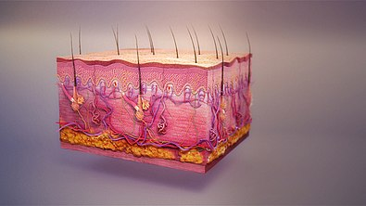
Integumentary System-Skin
The skin is the largest organ of the body. In humans, it accounts for about 12 to 15 percent of total body weight and covers 1.5-2m2 of surface area. The human skin (integument) is composed of at least two major layers of tissue: the epidermis and dermis. (The hypodermis or subcutaneous layer is not part of the skin. The epidermis is the outermost layer, providing the initial barrier to the external environment. It is separated from the dermis by the basement membrane. The epidermis contains melanocytes and gives color to the skin. The deepest layer of epidermis also contains nerve endings. Beneath this, the dermis comprises two sections, the papillary and reticular layers, and contains connective tissues, vessels, glands, follicles, hair roots, sensory nerve endings, and muscular tissue. The deepest layer, the hypodermis, is primarily made up of adipose tissue. Substantial collagen bundles anchor the dermis to the hypodermis in a way that permits most areas of the skin to move freely over the deeper tissue layers.

Slide 5
Epidermis
The epidermis is the top layer of skin made up of epithelial cells. It contains blood vessels. Its main functions are protection, absorption of nutrients, and homeostasis. In structure, it consists of a keratinized stratified squamous epithelium; four types of cells: keratinocytes, melanocytes, Merkel cells, and Langerhans cells. The major cell of the epidermis is the keratinocyte, which produces keratin, a fibrous protein that aids in skin protection. An overwhelming amount of keratin can cause disease by giving rise to eruptions from the skin that will protrude outwards and lead to infection.[citation needed] Keratin is also a waterproofing protein. Millions of dead keratinocytes rub off daily. The majority of the skin on the body is keratinized. The only skin on the body that is non-keratinized is the lining of mucous membranes, such as the inside of the mouth. Non-keratinized cells allow water to "stay" atop the structure.
The protein keratin stiffens epidermal tissue to form fingernails. Nails grow from a thin area called the nail matrix at an average of 1 mm per week. The lunula is the crescent-shape area at the base of the nail, lighter in color as it mixes with matrix cells. Also, the stratum corneum is the top part of the epidermis.

Slide 6
Dermis
The dermis is the middle layer of skin, composed of dense irregular connective tissue and areolar connective tissue such as a collagen with elastin arranged in a diffusely bundled and woven pattern. The dermis has two layers. One is the papillary layer which is the superficial layer and consists of the areolar connective tissue. The other is the reticular layer which is the deep layer of the dermis and consists of the dense irregular connective tissue. These layers serve to give elasticity to the integument, allowing stretching and conferring flexibility, while also resisting distortions, wrinkling, and sagging. The dermal layer provides a site for the endings of blood vessels and nerves. Many chromatophores are also stored in this layer, as are the bases of integumental structures such as hair, feathers, and glands. Try the suggestions below or type a new query above.

Slide 7
Hypodermis
The hypodermis, otherwise known as the subcutaneous layer, is a layer beneath the skin. It invaginates into the dermis and is attached to the latter, immediately above it, by collagen and elastin fibers. It is essentially composed of a type of cell known as adipocytes specialized in accumulating and storing fats. These cells are grouped together in lobules separated by connective tissue.
The hypodermis acts as an energy reserve. The fats contained in the adipocytes can be put back into circulation, via the venous route, during intense effort or when there is a lack of energy-providing substances, and are then transformed into energy. The hypodermis participates, passively at least, in thermoregulation since fat is a heat insulator.

Slide 8
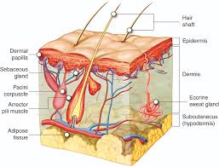
Integumentary System-Hair
A bundle of smooth muscle cells, forming the arrector pili muscle, is attached to each hair follicle. This muscle is positioned so that the hair within the follicle stands on end when the muscle contracts. If a person is emotionally upset or very cold, nerve impulses may stimulate the arrector pili muscles to contract, causing gooseflesh (or goose bumps). Each hair follicle is also associated with one or more sebaceous glands.
Hair is present on all skin surfaces except the palms, soles, lips, nipples, and various parts of the external reproductive organs; however, it is not always well developed. For example, it is very fine on the forehead and the inside surface of the arm. Each hair develops from a group of epidermal cells at the base of a tube-like depression called a hair follicle. This follicle extends from the surface into the dermis and may pass into the subcutaneous layer. The cells at its base receive nourishment from

Slide 9
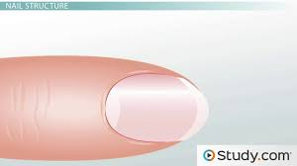
Integumentary System-Nails
A nail is a horn-like keratinous plate at the tip of the fingers and toes in most primates. Nails correspond to claws found in other animals. Fingernails and toenails are made of a tough protective protein called alpha-keratin which is found in the hooves, hair, claws and horns of vertebrates.[1]

Slide 10
Parts of the nail
The matrix, sometimes called the matrix unguis, keratogenous membrane, nail matrix, or onychostroma, is the tissue (or germinal matrix) which the nail protects. It is the part of the nail bed that is beneath the nail and contains nerves, lymph and blood vessels. The matrix produces cells that become the nail plate. The width and thickness of the nail plate is determined by the size, length, and thickness of the matrix, while the shape of the fingertip bone determines if the nail plate is flat, arched, or hooked. The matrix will continue to produce cells as long as it receives nutrition and remains in a healthy condition. As new nail plate cells are made, they push older nail plate cells forward; and in this way older cells become compressed, flat, and translucent. This makes the capillaries in the nail bed below visible, resulting in a pink color.
The lunula ("small moon") is the visible part of the matrix, the whitish crescent-shaped base of the visible nail.[9] The lunula can best be seen in the thumb and may not be visible in the little finger.
The nail bed is the skin beneath the nail plate. Like all skin, it is made of two types of tissues: the deeper dermis, the living tissue which includes capillaries and glands, and the epidermis, the layer just beneath the nail plate, which moves toward the finger tip with the plate. The epidermis is attached to the dermis by tiny longitudinal "grooves" called matrix crests (cristae matricis unguis). In old age, the nail plate becomes thinner, and these grooves become more visible.
The nail sinus (sinus unguis) is where the nail root is; i.e. the base of the nail underneath the skin. It originates from the actively growing tissue below, the matrix.
The nail plate (corpus unguis)[4] is the hard part of the nail, made of translucent keratin protein. Several layers of dead, compacted cells cause the nail to be strong but flexible.[6] Its (transverse) shape is determined by the form of the underlying bone.[6] In common usage, the word nail often refers to this part only.

Slide 11
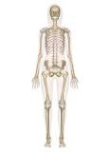
Skeleton System
The human skeleton is the internal framework of the human body. It is composed of around 270 bones at birth – this total decreases to around 206 bones by adulthood after some bones get fused together.[1] The bone mass in the skeleton reaches maximum density around age 21. The human skeleton can be divided into the axial skeleton and the appendicular skeleton. The axial skeleton is formed by the vertebral column, the rib cage, the skull and other associated bones. The appendicular skeleton, which is attached to the axial skeleton, is formed by the shoulder girdle, the pelvic girdle and the bones of the upper and lower limbs.
The human skeleton performs six major functions; support, movement, protection, production of blood cells, storage of minerals, and endocrine regulation.

Slide 12
Bones
As a human ages, some of its bones fuse, a process which typically lasts until sometime within the third decade of life. Therefore, the number of bones in an individual may be evaluated differently throughout their life. In addition, the bones of the skull and face are counted as separate bones, despite being fused naturally. Some reliable sesamoid bones such as the pisiform are counted, while others, such as the hallux sesamoids, are not.
Individuals may have more or fewer bones than the average (even accounting for developmental stage) owing to anatomical variations. The most common variations include sutural bones, which are located along the sutural lines on the back of the skull, and sesamoid bones which develop within some tendons, mainly in the hands and feet. Some individuals may also have additional (i.e., supernumerary) cervical ribs or lumbar vertebrae.

Slide 13
Joints
A joint or articulation (or articular surface) is the connection made between bones in the body which link the skeletal system into a functional whole. They are constructed to allow for different degrees and types of movement. Some joints, such as the knee, elbow, and shoulder, are self-lubricating, almost frictionless, and are able to withstand compression and maintain heavy loads while still executing smooth and precise movements. Other joints such as sutures between the bones of the skull permit very little movement (only during birth) in order to protect the brain and the sense organs. The connection between a tooth and the jawbone is also called a joint, and is described as a fibrous joint known as a gomphosis. Joints are classified both structurally and functionally.

Slide 14
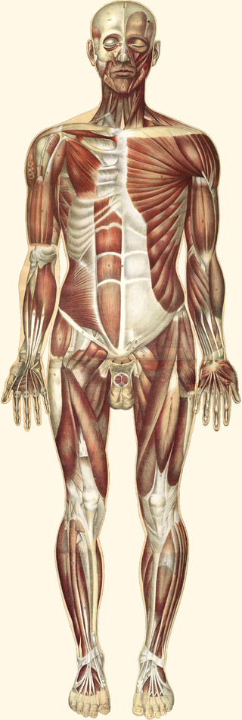
Muscular System
The muscular system is an organ system consisting of skeletal, smooth and cardiac muscles. It permits movement of the body, maintains posture and circulates blood throughout the body. The muscular systems in vertebrates are controlled through the nervous system although some muscles (such as the cardiac muscle) can be completely autonomous. Together with the skeletal system, it forms the musculoskeletal system, which is responsible for movement of the human body.

Slide 15
Muscles
Skeletal muscles, like other striated muscles, are composed of myocytes, or muscle fibers, which are in turn composed of myofibrils, which are composed of sarcomeres, the basic building block of striated muscle tissue. Upon stimulation by an action potential, skeletal muscles perform a coordinated contraction by shortening each sarcomere. The best proposed model for understanding contraction is the sliding filament model of muscle contraction. Within the sarcomere, actin and myosin fibers overlap in a contractile motion towards each other. Myosin filaments have club-shaped heads that project toward the actin filaments.
There are three distinct types of muscles: skeletal muscles, cardiac or heart muscles, and smooth (non-striated) muscles. Muscles provide strength, balance, posture, movement and heat for the body to keep warm.
Smooth muscles are controlled directly by the autonomic nervous system and are involuntary, meaning that they are incapable of being moved by conscious thought. Functions such as heartbeat and lungs (which are capable of being willingly controlled, be it to a limited extent) are involuntary muscles but are not smooth muscles.
Cardiac muscles are distinct from skeletal muscles because the muscle fibers are laterally connected to each other. Furthermore, just as with smooth muscles, their movement is involuntary. Heart muscles are controlled by the sinus node influenced by the autonomic nervous system.

Slide 16
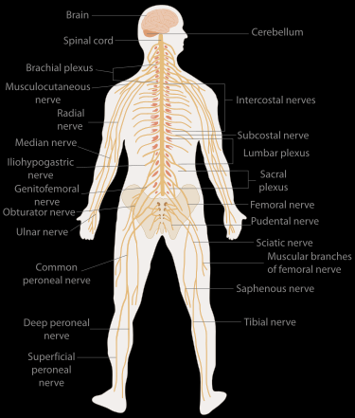
Nervous System
The nervous system is a highly complex part of an animal that coordinates its actions and sensory information by transmitting signals to and from different parts of its body. The nervous system detects environmental changes that impact the body, then works in tandem with the endocrine system to respond to such events.[1] Nervous tissue first arose in wormlike organisms about 550 to 600 million years ago. In vertebrates it consists of two main parts, the central nervous system (CNS) and the peripheral nervous system (PNS). The CNS consists of the brain and spinal cord. The PNS consists mainly of nerves, which are enclosed bundles of the long fibers or axons, that connect the CNS to every other part of the body. Nerves that transmit signals from the brain are called motor or efferent nerves, while those nerves that transmit information from the body to the CNS are called sensory or afferent. Spinal nerves serve both functions and are called mixed nerves. The PNS is divided into three separate subsystems, the somatic, autonomic, and enteric nervous systems. Somatic nerves mediate voluntary movement. The autonomic nervous system is further subdivided into the sympathetic and the parasympathetic nervous systems. The sympathetic nervous system is activated in cases of emergencies to mobilize energy, while the parasympathetic nervous system is activated when organisms are in a relaxed state. The enteric nervous system functions to control the gastrointestinal system. Both autonomic and enteric nervous systems function involuntarily. Nerves that exit from the cranium are called cranial nerves while those exiting from the spinal cord are called spinal nerves.

Slide 17
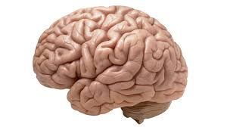
Brain
The human brain is the central organ of the human nervous system, and with the spinal cord makes up the central nervous system. The brain consists of the cerebrum, the brainstem and the cerebellum. It controls most of the activities of the body, processing, integrating, and coordinating the information it receives from the sense organs, and making decisions as to the instructions sent to the rest of the body. The brain is contained in, and protected by, the skull bones of the head.

Slide 18
Parts of Brain
The cerebellum is divided into an anterior lobe, a posterior lobe, and the flocculonodular lobe.[ The anterior and posterior lobes are connected in the middle by the vermis. Compared to the cerebral cortex, the cerebellum has a much thinner outer cortex that is narrowly furrowed into numerous curved transverse fissures. Viewed from underneath between the two lobes is the third lobe the flocculonodular lobe. The cerebellum rests at the back of the cranial cavity, lying beneath the occipital lobes, and is separated from these by the cerebellar tentorium, a sheet of fiber.
The cerebrum is the largest part of the brain, and is divided into nearly symmetrical left and right hemispheres by a deep groove, the longitudinal fissure. Asymmetry between the lobes is noted as a petalia. The hemispheres are connected by five commissures that span the longitudinal fissure, the largest of these is the corpus callosum. Each hemisphere is conventionally divided into four main lobes; the frontal lobe, parietal lobe, temporal lobe, and occipital lobe, named according to the skull bones that overlie them. Each lobe is associated with one or two specialized functions though there is some functional overlap between them. The surface of the brain is folded into ridges (gyri) and grooves (sulci), many of which are named, usually according to their position, such as the frontal gyrus of the frontal lobe or the central sulcus separating the central regions of the hemispheres. There are many small variations in the secondary and tertiary folds.
The brainstem lies beneath the cerebrum and consists of the midbrain, pons and medulla. It lies in the back part of the skull, resting on the part of the base known as the clivus, and ends at the foramen magnum, a large opening in the occipital bone. The brainstem continues below this as the spinal cord, protected by the vertebral column.

Slide 19
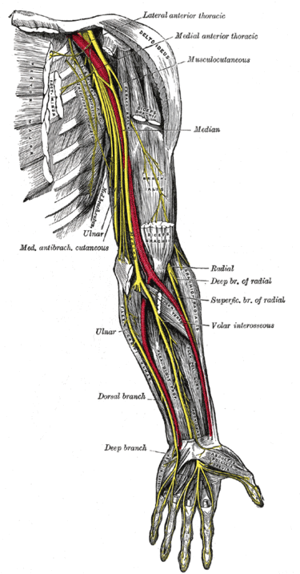
Nerves
A nerve is an enclosed, cable-like bundle of nerve fibres called axons, in the peripheral nervous system. A nerve transmits electrical impulses and is the basic unit of the peripheral nervous system. A nerve provides a common pathway for the electrochemical nerve impulses called action potentials that are transmitted along each of the axons to peripheral organs or, in the case of sensory nerves, from the periphery back to the central nervous system. Each axon within the nerve is an extension of an individual neuron, along with other supportive cells such as some Schwann cells that coat the axons in myelin.

Slide 20
Nerve Cells
A neuron, neurone (old British spelling) or nerve cell, is an electrically excitable cellthat communicates with other cells via specialized connections called synapses. It is the main component of nervous tissue in all animals except sponges and placozoa. Plants and fungi do not have nerve cells.
Neurons are typically classified into three types based on their function. Sensory neurons respond to stimuli such as touch, sound, or light that affect the cells of the sensory organs, and they send signals to the spinal cord or brain. Motor neurons receive signals from the brain and spinal cord to control everything from muscle contractions to glandular output. Interneurons connect neurons to other neurons within the same region of the brain or spinal cord. A group of connected neurons is called a neural circuit.

Slide 21
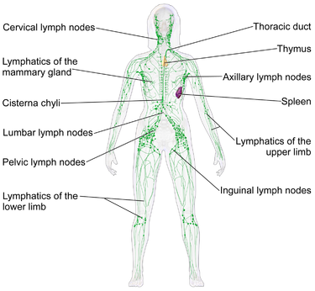
Lymphatic System
The lymphatic system, or lymphoid system, is an organ system in vertebrates that is part of the circulatory system and the immune system. It is made up of a large network of lymphatic vessels, lymphatic or lymphoid organs, and lymphoid tissues. The vessels carry a clear fluid called lymph (the Latin word lymph refers to the deity of fresh water, "Lymph" towards the heart.

Slide 22
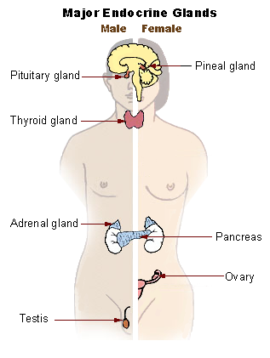
Endocrine System
The endocrine system is a chemical messenger system comprising feedback loops of the hormones released by internal glands of an organism directly into the circulatory system, regulating distant target organs. In humans, the major endocrine glands are the thyroid gland and the adrenal glands. In vertebrates, the hypothalamus is the neural control center for all endocrine systems. The study of the endocrine system and its disorders is known as endocrinology. Endocrinology is a branch of internal medicine.

Slide 23
Hormones
Hormones are chemical messengers that are secreted directly into the blood, which carries them to organs and tissues of the body to exert their functions. There are many types of hormones that act on different aspects of bodily functions and processes.
The glands that secrete hormones comprise the endocrine signaling system. The term "hormone" is sometimes extended to include chemicals produced by cells that affect the same cell (autocrine or intracrine signaling) or nearby cells (paracrine signalling).

Slide 24
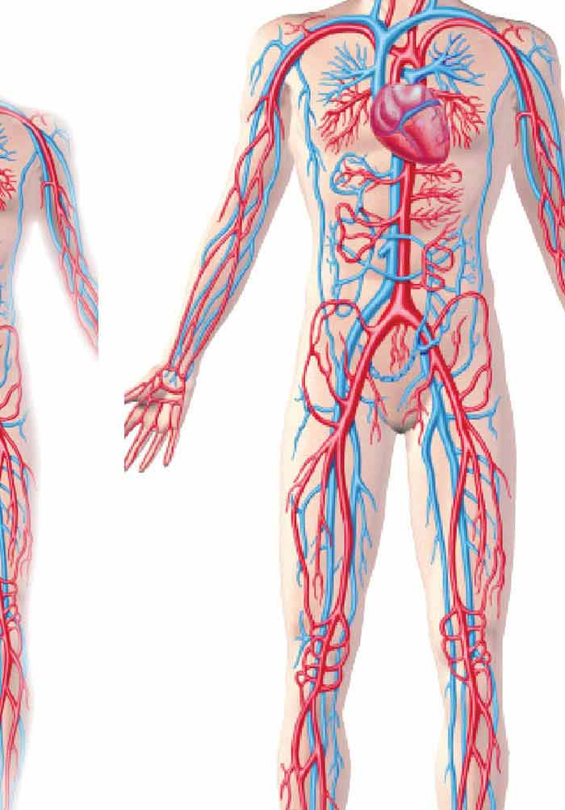
Cardiovascular System
The circulatory system, also called the cardiovascular system or the vascular system, is an organ system that permits blood to circulate and transport nutrients (such as amino acids and electrolytes), oxygen, carbon dioxide, hormones, and blood cells to and from the cells in the body to provide nourishment and help in fighting diseases, stabilize temperature and pH, and maintain homeostasis.
The circulatory system includes the lymphatic system, which circulates lymph.[1] The passage of lymph takes much longer than that of blood.[2] Blood is a fluid consisting of plasma, red blood cells, white blood cells, and platelets that is circulated by the heart through the vertebrate vascular system, carrying oxygen and nutrients to and waste materials away from all body tissues. Lymph is essentially recycled excess blood plasma after it has been filtered from the interstitial fluid (between cells) and returned to the lymphatic system. The cardiovascular (from Latin words meaning "heart" and "vessel") system comprises the blood, heart, and blood vessels.[3] The lymph, lymph nodes, and lymph vessels form the lymphatic system, which returns filtered blood plasma from the interstitial fluid (between cells) as lymph.

Slide 25
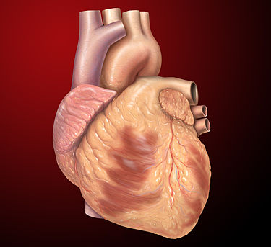
The Heart
The heart is a muscular organ in most animals, which pumps blood through the blood vessels of the circulatory system.[1] The pumped blood carries oxygen and nutrients to the body, while carrying metabolic waste such as carbon dioxide to the lungs.[2] In humans, the heart is approximately the size of a closed fist and is located between the lungs, in the middle compartment of the chest.

Slide 26
Arteries and Veins
An artery (plural arteries)meaning 'windpipe, artery') is a blood vessel that takes blood away from the human heart to all parts of the body (tissues, lungs, Brain etc.). Most arteries carry oxygenated blood; the two exceptions are the pulmonary and the umbilical arteries, which carry deoxygenated blood to the organs that oxygenate it (lungs). The effective arterial blood volume is that extracellular fluid which fills the arterial system.
Veins are blood vessels that carry blood towards the heart. Most veins carry deoxygenated blood from the tissues back to the heart; exceptions are the pulmonary and umbilical veins, both of which carry oxygenated blood to the heart. In contrast to veins, arteries carry blood away from the heart.
Veins are less muscular than arteries and are often closer to the skin. There are valves in most veins to prevent backflow.

Slide 27
Capillaries
A capillary is a small blood vessel from 5 to 10 micrometers in diameter, and having a wall one endothelial cell thick. They are the smallest blood vessels in the body: they convey blood between the arterioles and venules. These micro vessels are the site of exchange of many substances with the interstitial fluid surrounding them. Substances which exit include water (proximal portion), oxygen, and glucose; substances which enter include water (distal portion), carbon dioxide, uric acid, lactic acid, urea and creatinine. Lymph capillaries connect with larger lymph vessels to drain lymphatic fluid collected in the microcirculation.

Slide 28
Blood
Blood is a body fluid in humans and other animals that delivers necessary substances such as nutrients and oxygen to the cells and transports metabolic waste products away from those same cells.

Slide 29
Blood Cells
A blood cell, also called a hematopoietic cell, hemocyte, or hematocyte, is a cell produced through hematopoiesis and found mainly in the blood. Major types of blood cells include;
Red blood cells (erythrocytes)
White blood cells (leukocytes)
Platelets (thrombocytes)

Slide 30
Red Blood Cells
Red blood cells or erythrocytes, primarily carry oxygen and collect carbon dioxide through the use of hemoglobin.[2] Hemoglobin is an iron-containing protein that gives red blood cells their color and facilitates transportation of oxygen from the lungs to tissues and carbon dioxide from tissues to the lungs to be exhaled.[3] Red blood cells are the most abundant cell in the blood, accounting for about 40-45% of its volume. Red blood cells are circular, biconcave, disk-shaped and deformable to allow them to squeeze through narrow capillaries. They do not have a nucleus. Red blood cells are much smaller than most other human cells.
RBCs are formed in the red bone marrow from hematopoietic stem cells in a process known as erythropoiesis. In adults, about 2.4 million RBCs are produced each second. The normal RBCs count is 4.5 to 5 millions per cu.mm. RBCs have a lifespan of approximately 100-120 days. After they have completed their lifespan, they are removed from the bloodstream by the spleen.

Slide 31
White Blood Cells
White blood cells or leukocytes, are cells of the immune system involved in defending the body against both infectious disease and foreign materials. They are produced and derived from multipotent cells in the bone marrow known as a hematopoietic stem cells. Leukocytes are found throughout the body, including the blood and lymphatic system. There are a variety of types of white bloods cells that serve specific roles in the human immune system. WBCs constitute approximately 1% of the blood volume.

Slide 32
Platelets
Platelets, or thrombocytes, are very small, irregularly shaped clear cell fragments, 2-3 micrometer in diameter, which derive from fragmentation of megakaryocytes. The average lifespan of a platelet is normally just 5 to 9 days. Platelets are a natural source of growth factors. They circulate in the blood of mammals and are involved in hemostasis, leading to the formation of blood clots. Platelets release thread-like fibers to form these clots.

Slide 33
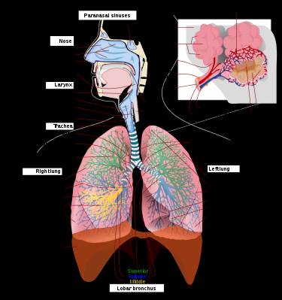
Respiratory System
The respiratory system (also respiratory apparatus, ventilatory system) is a biological system consisting of specific organs and structures used for gas exchange in animals and plants. The anatomy and physiology that make this happen varies greatly, depending on the size of the organism, the environment in which it lives and its evolutionary history. In land animals the respiratory surface is internalized as linings of the lungs. Gas exchange in the lungs occurs in millions of small air sacs called alveoli in mammals and reptiles, but atria in birds. These microscopic air sacs have a very rich blood supply, thus bringing the air into close contact with the blood. These air sacs communicate with the external environment via a system of airways, or hollow tubes, of which the largest is the trachea, which branches in the middle of the chest into the two main bronchi. These enter the lungs where they branch into progressively narrower secondary and tertiary bronchi that branch into numerous smaller tubes, the bronchioles. In birds the bronchioles are termed parabronchi. It is the bronchioles, or parabronchi that generally open into the microscopic alveoli in mammals and atria in birds. Air has to be pumped from the environment into the alveoli or atria by the process of breathing which involves the muscles of respiration.

Slide 34
Nose
The human nose is the most protruding part of the face. It bears the nostrils and is the first organ of the respiratory system. It is also the principal organ in the olfactory system. The shape of the nose is determined by the nasal bones and the nasal cartilages, including the nasal septum which separates the nostrils and divides the nasal cavity into two. On average the nose of a male is larger than that of a female.

Slide 35
Trachea(Windpipe)
The trachea, colloquially called the windpipe, is a cartilaginous tube that connects the larynx to the bronchi of the lungs, allowing the passage of air, and so is present in almost all air-breathing animals with lungs. The trachea extends from the larynx and branches into the two primary bronchi. At the top of the trachea the cricoid cartilage attaches it to the larynx. The trachea is formed by a number of horseshoe-shaped rings, joined together vertically by ligaments over their substance and by the trachealis muscle at their ends. The epiglottis closes the opening to the larynx during swallowing.

Slide 36
Lungs
The lungs are the primary organs of the respiratory system in humans and many other animals including a few fish and some snails. In mammals and most other vertebrates, two lungs are located near the backbone on either side of the heart. Their function in the respiratory system is to extract oxygen from the atmosphere and transfer it into the bloodstream, and to release carbon dioxide from the bloodstream into the atmosphere, in a process of gas exchange. Respiration is driven by different muscular systems in different species. Mammals, reptiles and birds use their different muscles to support and foster breathing. In early tetra pods, air was driven into the lungs by the pharyngeal muscles via buccal pumping, a mechanism still seen in amphibians. In humans, the main muscle of respiration that drives breathing is the diaphragm. The lungs also provide airflow that makes vocal sounds including human speech possible.
The left lung is divided into two lobes, an upper and a lower lobe, by the oblique fissure, which extends from the costal to the mediastinal surface of the lung both above and below the hilum. The left lung, unlike the right, does not have a middle lobe, though it does have a homologous feature, a projection of the upper lobe termed the lingula. Its name means "little tongue". The lingula on the left lung serves as an anatomic parallel to the middle lobe on the right lung, with both areas being predisposed to similar infections and anatomic complications. There are two bronchopulmonary segments of the lingula: superior and inferior
The right lung has both more lobes and segments than the left. It is divided into three lobes, an upper, middle, and a lower lobe by two fissures, one oblique and one horizontal. The upper, horizontal fissure, separates the upper from the middle lobe. It begins in the lower oblique fissure near the posterior border of the lung, and, running horizontally forward, cuts the anterior border on a level with the sternal end of the fourth costal cartilage; on the mediastinal surface it may be traced back to the hilum.

Slide 37
Bronchioles
The bronchioles or bronchiole are the smaller branches of the bronchial airways in the respiratory tract. They include the terminal bronchioles, and finally the respiratory bronchioles that mark the start of the respiratory zone delivering air to the gas exchanging units of the alveoli. The bronchioles no longer contain the cartilage, that is found in the bronchi, or glands in their submucosa.

Slide 38
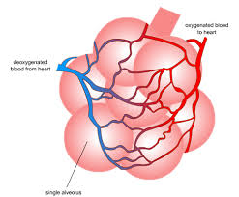
Alveolus
An alveolus (plural: alveoli) is a word used in anatomy for hollow cavities, which are empty areas within a body.
Although there are many different types of alveoli in the body, the word alveoli is usually used to talk about small air sacs in the lungs of mammals. These are also called pulmonary alveoli. These alveoli are located at the ends of the air passageways in the lungs. They have very thin (one cell thick), wet walls and are surrounded with a network of small blood vessels, or capillaries. This allows gases to diffuse, or move across, the surface of the alveolus.

Slide 39
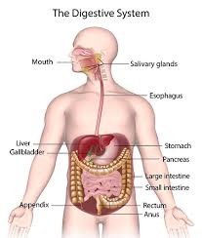
Digestive System
The human digestive system consists of the gastrointestinal tract plus the accessory organs of digestion (the tongue, salivary glands, pancreas, liver, and gallbladder). Digestion involves the breakdown of food into smaller and smaller components, until they can be absorbed and assimilated into the body. The process of digestion has three stages. The first stage is the cephalic phase of digestion which begins with gastric secretions in response to the sight and smell of food. This stage includes the mechanical breakdown of food by chewing, and the chemical breakdown by digestive enzymes, that takes place in the mouth.

Slide 40
Mouth
There are three pairs of main salivary glands and between 800 and 1,000 minor salivary glands, all of which mainly serve the digestive process, and also play an important role in the maintenance of dental health and general mouth lubrication, without which speech would be impossible. The main glands are all exocrine glands, secreting via ducts. All of these glands terminate in the mouth.
The mouth is the first part of the upper gastrointestinal tract and is equipped with several structures that begin the first processes of digestion. These include salivary glands, teeth and the tongue.
Food enters the mouth where the first stage in the digestive process takes place, with the action of the tongue and the secretion of saliva. The tongue is a fleshy and muscular sensory organ, and the very first sensory information is received via the taste buds in the papillae on its surface.
Taste is a form of chemoreception that takes place in the specialised taste receptors, contained in structures called taste buds in the mouth.
Saliva moistens and softens food, and along with the chewing action of the teeth, transforms the food into a smooth bolus. The bolus is further helped by the lubrication provided by the saliva in its passage from the mouth into the esophagus.
Teeth are complex structures made of materials specific to them. They are made of a bone-like material called dentin, which is covered by the hardest tissue in the body—enamel. Teeth have different shapes to deal with different aspects of mastication employed in tearing and chewing pieces of food into smaller and smaller pieces. This results in a much larger surface area for the action of digestive enzymes.

Slide 41
Pharynx
The pharynx is a part of the conducting zone of the respiratory system and also a part of the digestive system. It is the part of the throat immediately behind the nasal cavity at the back of the mouth and above the esophagus and larynx.
The pharynx is made up of three parts. The lower two parts—the oropharynx and the laryngopharynx are involved in the digestive system. The laryngopharynx connects to the esophagus and it serves as a passageway for both air and food. Air enters the larynx anteriorly but anything swallowed has priority and the passage of air is temporarily blocked. The pharynx is innervated by the pharyngeal plexus of the vagus nerve. Muscles in the pharynx push the food into the esophagus. The pharynx joins the esophagus at the esophageal inlet which is located behind the cricoid cartilage.

Slide 42
Larynx
The larynx , commonly called the voice box, is an organ in the top of the neck involved in breathing, producing sound and protecting the trachea against food aspiration. The larynx houses the vocal folds, and manipulates pitch and volume, which is essential for phonation. It is situated just below where the tract of the pharynx splits into the trachea and the esophagus. The word larynx (plural larynges) comes from a similar Ancient Greek word.

Slide 43
Oesophagus(Food Pipe)
The esophagus, (American English) or oesophagus (British English; see spelling differences) , informally known as the food pipe or gullet, is an organ in vertebrates through which food passes, aided by peristaltic contractions, from the pharynx to the stomach. The esophagus is a fibromuscular tube, about 25 cm (10 in) long in adults, which travels behind the trachea and heart, passes through the diaphragm and empties into the uppermost region of the stomach. During swallowing, the epiglottis tilts backwards to prevent food from going down the larynx and lungs. The word oesophagus is the Greek word oisophagos, meaning "gullet".

Slide 44
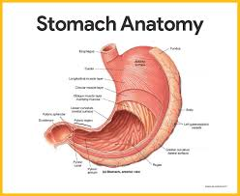
Stomach
The stomach is a major organ of the gastrointestinal tract and digestive system. It is a consistently J-shaped organ joined to the esophagus at its upper end and to the duodenum at its lower end. Gastric acid (informally gastric juice), produced in the stomach plays a vital role in the digestive process, and mainly contains hydrochloric acid and sodium chloride. A peptide hormone, gastrin, produced by G cells in the gastric glands, stimulates the production of gastric juice which activates the digestive enzymes. Pepsinogen is a precursor enzyme (zymogen) produced by the gastric chief cells, and gastric acid activates this to the enzyme pepsin which begins the digestion of proteins. As these two chemicals would damage the stomach wall, mucus is secreted by innumerable gastric glands in the stomach, to provide a slimy protective layer against the damaging effects of the chemicals on the inner layers of the stomach.

Slide 45
Liver, Pancreas and Gall bladder
The liver is the second largest organ (after the skin) and is an accessory digestive gland which plays a role in the body's metabolism. The liver has many functions some of which are important to digestion. The liver can detoxify various metabolites; synthesize proteins and produce biochemicals needed for digestion. It regulates the storage of glycogen which it can form from glucose (glycogenesis).
The pancreas is a major organ functioning as an accessory digestive gland in the digestive system. It is both an endocrine gland and an exocrine gland. The endocrine part secretes insulin when the blood sugar becomes high; insulin moves glucose from the blood into the muscles and other tissues for use as energy.
The gallbladder is a hollow part of the biliary tract that sits just beneath the liver, with the gallbladder body resting in a small depression. It is a small organ where the bile produced by the liver is stored, before being released into the small intestine.

Slide 46
Intestines
In the large intestine, the passage of the digesting food in the colon is a lot slower, taking from 30 to 40 hours until it is removed by defecation. The colon mainly serves as a site for the fermentation of digestible matter by the gut flora. The time taken varies considerably between individuals. The remaining semi-solid waste is termed feces and is removed by the coordinated contractions of the intestinal walls, termed peristalsis, which propels the excreta forward to reach the rectum and exit via defecation from the anus. The wall has an outer layer of longitudinal muscles, the taeniae coli, and an inner layer of circular muscles. The circular muscle keeps the material moving forward and also prevents any back flow of waste. Also of help in the action of peristalsis is the basal electrical rhythm that determines the frequency of contractions. The taeniae coli can be seen and are responsible for the bulges (haustra) present in the colon. Most parts of the GI tract are covered with serous membranes and have a mesentery. Other more muscular parts are lined with adventitia.
Partially digested food starts to arrive in the small intestine as semi-liquid chyme, one hour after it is eaten.[citation needed] The stomach is half empty after an average of 1.2 hours. After four or five hours the stomach has emptied.
In the small intestine, the pH becomes crucial; it needs to be finely balanced in order to activate digestive enzymes. The chyme is very acidic, with a low pH, having been released from the stomach and needs to be made much more alkaline. This is achieved in the duodenum by the addition of bile from the gall bladder combined with the bicarbonate secretions from the pancreatic duct and also from secretions of bicarbonate-rich mucus from duodenal glands known as Brunner's glands. The chyme arrives in the intestines having been released from the stomach through the opening of the pyloric sphincter.

Slide 47
Immune System
The immune system is a host defense system comprising many biological structures and processes within an organism that protects against disease. To function properly, an immune system must detect a wide variety of agents, known as pathogens, from viruses to parasitic worms, and distinguish them from the organism's own healthy tissue. In many species, there are two major subsystems of the immune system: the innate immune system and the adaptive immune system. Both subsystems use humoral immunity and cell-mediated immunity to perform their functions. In humans, the blood–brain barrier, blood–cerebrospinal fluid barrier, and similar fluid–brain barriers separate the peripheral immune system from the neuroimmune system, which protects the brain.
Information of White Blood cells is in Slide 31

Slide 48
Urinary System
The urinary system, also known as the renal system or urinary tract, consists of the kidneys, ureters, bladder, and the urethra. The purpose of the urinary system is to eliminate waste from the body, regulate blood volume and blood pressure, control levels of electrolytes and metabolites, and regulate blood pH. The urinary tract is the body's drainage system for the eventual removal of urine. The kidneys have an extensive blood supply via the renal arteries which leave the kidneys via the renal vein. Each kidney consists of functional units called nephrons. Following filtration of blood and further processing, wastes (in the form of urine) exit the kidney via the ureters, tubes made of smooth muscle fibers that propel urine towards the urinary bladder, where it is stored and subsequently expelled from the body by urination (voiding). The female and male urinary system are very similar, differing only in the length of the urethra.

Slide 49
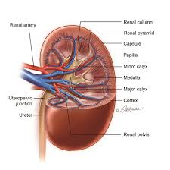
Kidney(s)
The kidney(s) are two bean-shaped organs found in vertebrates. They are located on the left and right in the retroperitoneal space, and in adult humans are about 12 centimeters (4 1⁄2 inches) in length. They receive blood from the paired renal arteries; blood exits into the paired renal veins. Each kidney is attached to a ureter, a tube that carries excreted urine to the bladder.

Slide 50
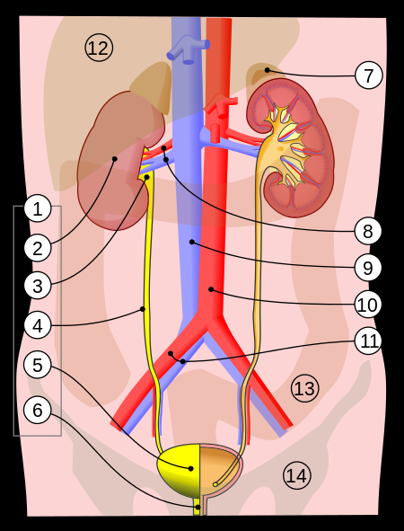
Bladder
The urinary bladder or simply bladder is a hollow muscular organ in humans and other vertebrates that collects and stores urine from the kidneys before disposal by urination. In the human the bladder is a hollow muscular, and distensible (or elastic) organ, that sits on the pelvic floor. Urine enters the bladder via the ureters and exits via the urethra. The typical human bladder will hold between 300 and 500 ml (10.14 and 16.91 FL oz) before the urge to empty occurs, but can hold considerably more.

Slide 51
Reproductive System
The reproductive system of an organism, also known as the genital system, is the biological system made up of all the anatomical organs involved in sexual reproduction. Many non-living substances such as fluids, hormones, and pheromones are also important accessories to the reproductive system. Unlike most organ systems, the sexes of differentiated species often have significant differences. These differences allow for a combination of genetic material between two individuals, which allows for the possibility of greater genetic fitness of the offspring.

Slide 52
Sperm and Egg
Sperm is the male reproductive cell, or gamete, in anisogamous forms of sexual reproduction (forms in which there is a larger, "female" reproductive cell and a smaller, "male" one). Animals produce motile sperm with a tail known as a flagellum, which are known as spermatozoa, while some red algae and fungi produce non-motile sperm cells, known as spermatia. Flowering plants contain non-motile sperm inside pollen, while some more basal plants like ferns and some gymnosperms have motile sperm.
The egg , or ovum (plural ova), is the female reproductive cell, or gamete, in most anisogamous organisms (organisms that reproduce sexually with a larger, "female" gamete and a smaller, "male" one). The term is used when the female gamete is not capable of movement (non-motile). If the male gamete (sperm) is capable of movement, the type of sexual reproduction is also classified as oogamous.

Slide 53
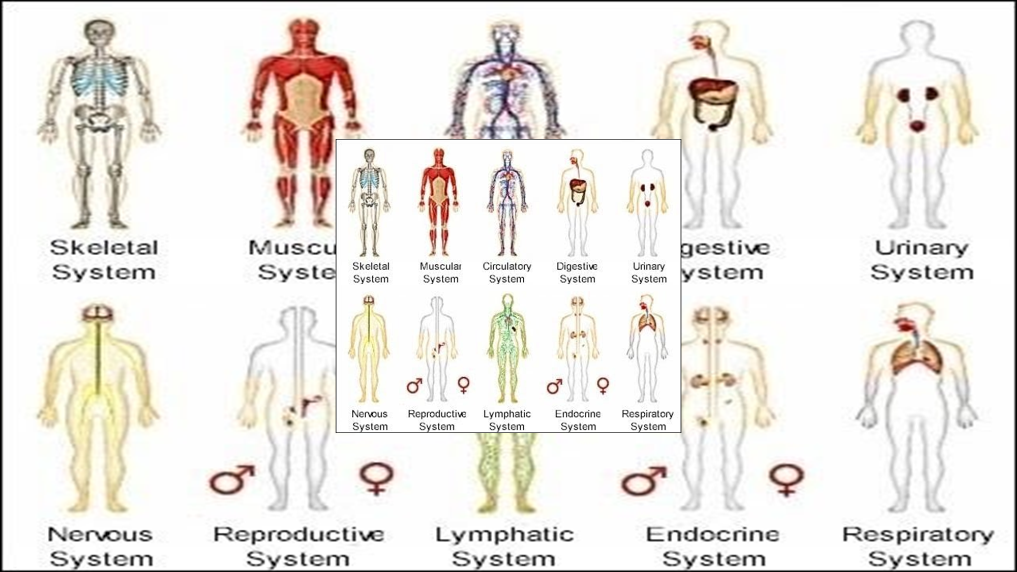
Thankyou

